Slide 1
GQP Project Proposal
WPI - Basis Technology
Jing Yu, Kratika Agrawal, Soumya Joshi, Xinlu He, Vandana Anand, Min Huang
Notes:
GQP Project Proposal in collaboration with Basis Technology, a company that for over 20 years provide analytics enabling businesses and governments to tackle some of their toughest problems. Among the projects include verifying identity, understanding customers, anticipating world events, uncovering crime.

Slide 2






Project Team Introduction
Sponsors & Mentors
Gil Irizarry Kfir Bar
Vice President - Engineering Chief Scientist
gil@basistech.com kfir@basistech.com
Team Members
Vandana Anand vanand@wpi.edu 978-427-5212 | Kratika Agrawal kagrawal@wpi.edu 774-701-9288 | Jing Yu jyu5@wpi.edu 608-886-8578 | Soumya Joshi sjoshi2@wpi.edu 508-615-8354 | Min Huang mhuang3@wpi.edu 774-253-5410 | Xinlu He xhe4@wpi.edu 774-253-8221

Slide 3

Project Description
Basis Technology wants to improve the current text analytics tool Rosette by applying artificial intelligence and deep learning techniques to increase entity linking performance with unstructured data.
Notes:
Unstructured data is hard to decipher so they aim to extract meaningful insight from it

Slide 4
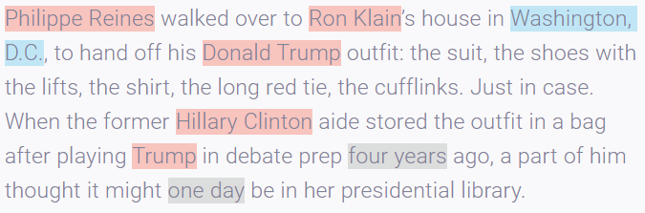
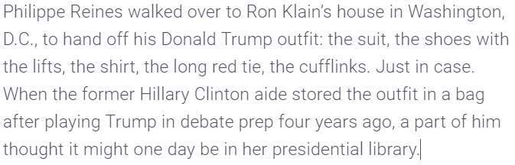
Entity Linking
Given any text document, identify all Mentions/Entities.
Mentions/Entities -> Noun (Person, Organisation, Location, etc)
Link identified Entities to a descriptive Database item (Wikipedia, Wikidata)

Slide 5
Entity Linking
Step 1:
Entity Detection/Mention Detection
Already implemented and working efficiently
Step 2:
Entity Linking to Database
Database: Wikidata
Implemented and working efficiently for various scenarios
Step 3:
Entity Disambiguation
Disambiguate the entity based on the entire text reference and link to a particular record in the database.
Notes:
3 parts to entity linking
We have to identify the named entity mention
Entity linking to database- whether the entity exists
Mapping NE to k database for ambiguous entities (entities have same name different people/place)

Slide 6
Project Plan
This project will include:
gathering data and building knowledge base,
annotating data,
evaluating current entity linking algorithms,
designing and building neural network models for entity linking,
comparing the performance of the neural network algorithms versus the current SOTA algorithms.
Notes:
Data labelling
A machine learning project

Slide 7
Dataset
Public Dataset for Algorithm Performance Evaluation:
AIDA CoNLL-YAGO Dataset
Real time implementation:
New Dataset from Basis Technology

Slide 8
Data Pre-Processing
AIDA CoNLL-YAGO dataset (for use in current stage)
Apply for the original CoNLL 2003 dataset
Create YAGO2, Freebase and Wikipedia entity annotations of the original dataset by applying given tool
Handle inconsistencies in the data and normalize the text
Partitioned into train, testA, testB datasets
New dataset from Basis Technology (for use in next stage)
Annotate data based on given guideline
Notes:
Based on README

Slide 9
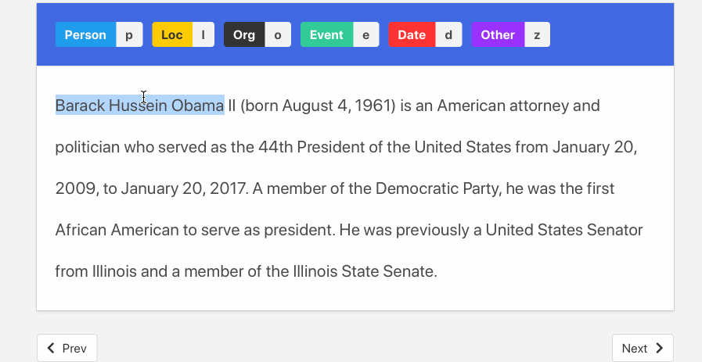
Data Pre-Processing
Annotate data based on given guideline
Demo provided by Doccano
Notes:
Based on README

Slide 10
Project Methodology
Implementing and Comparing 3 models parallelly
End-to-End Entity Linking (LSTM, FFNN)
Deep Type (Neural Type System)
Latent Relations Model (Neural Multi-relational models)

Slide 11
Project Methodology
Entity linking can be split into two classes of approaches:
End-to-End : processing a piece of text to extract the entities (i.e. Named Entity Recognition) and then disambiguate these extracted entities to the correct entry in a given knowledge base (e.g. Wikidata, DBpedia, YAGO).
End-to-End Entity Linking model
Disambiguation-Only: directly takes gold standard named entities as input and only disambiguates them to the correct entry in a given knowledge base.
DeepType model, Latent relations model

Slide 12
Entity disambiguation(ED)
The task of linking mentions of ambiguous entities to their referent entities in a knowledge base such as Wikipedia/Wikidata.
“Charles Abbot researched the Solar constant, which let him to invent solar cooker”
Charles Abbot, 1st Baron Colchester (1757–1829), British statesman
Charles Abbot, 2nd Baron Colchester (1798–1867), British politician
Charles Greeley Abbot (1872–1973), American astrophysicist and astronomer
Charles Abbot (botanist) (1761–1817), British botanist and entomologist
Charles S. Abbot (born 1945), American admiral
Charles Wheaton Abbot Jr. (1860–1923), American military officer

Slide 13
Entity disambiguation(ED)
Features:
Context- Independent Features
LinkCount: the numbers of mentions linking to entities #(m->e) (DeepType Model)
Entity Attributes: Type, Popularity
Context- Dependent Features
Textual Context
Coherence Between Entities (Latent relations model)

Slide 14
Key Concepts and Methods
End-to-End Entity Linking model
Combine the Mention Detection and Entity Disambiguation in one model
Consider both local score and global score, according to which to decide the final entity candidate.
DeepType Model
Builds the Type System for each Mention in the text document. Eg. Washington {Person, Place}
Classify to find the best Type System.
Use the identified Type to disambiguate among Entities.
Latent relations Model
Apply representation algorithm to extract feature
Innovatively take into account latent relations between entities

Slide 15
Outcomes, Results, Deliverables
Pros and cons of each methodology
Evaluation (F1 scores) for each methodology
Experimenting and implementing novel ideas based on the three algorithms
Reporting and evaluating the performance of neural networks on entity linking
Suggestions on future work

Slide 16
Related Materials
[1] End-to-End Neural Entity Linking, https://arxiv.org/pdf/1808.07699.pdf
[2] DeepType: Multilingual Entity Linking by Neural Type System Evolution, https://arxiv.org/pdf/1802.01021.pdf
[3] Latent Entity Modelling 1: https://arxiv.org/pdf/1804.10637.pdf
[4] Latent Entity Modelling 2: https://arxiv.org/pdf/2001.01447.pdf
[5] Repository to track the progress in Natural Language Processing (NLP), http://nlpprogress.com/english/entity_linking.html
[6] End to End Github Link: https://github.com/dalab/end2end_neural_el
[7] Deeptype Github Link: https://github.com/openai/deeptype
[8] Latent Github Link: https://github.com/izuna385/Entity-Linking-Recent-Trends
[9] Basis Technology Company Info: https://www.basistech.com/about/
[10] Training Entity Embeddings: https://github.com/dalab/deep-ed/

Slide 17
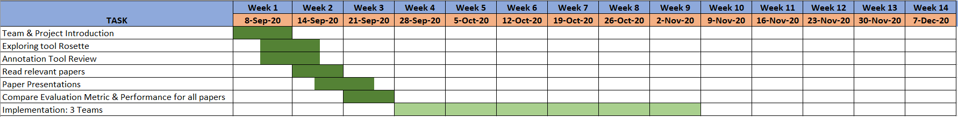
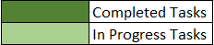
Project Timeline

Slide 18
Demo
https://try.rosette.com

Slide 19
Q & A Session

Slide 20
Extra Slides

Slide 21
Data Annotation
Data Annotation is the process where specialists label the dataset so that it can be used by machine learning algorithms.Data labelling is a key factor in achieving high performance in ML algorithms
Current state of the Art
Basis Technology is currently focusing on Entity annotation for their Entity linking tool Rosette.
The current annotation process is based upon random selection of unlabelled data for annotation and is repeated until optimum performance is achieved.

Slide 22
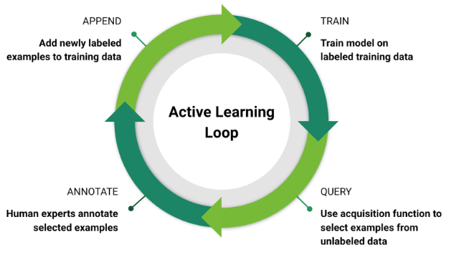
Data Annotation
The goal is to implement an Active Learning process where the annotation tool and ML classifier go hand in hand leading to a more optimised annotation process and improved performance.

